Slide 1
Mobile-Commerce Development
Lesson
Dialogs and Notifications
Lecturer:
Tran Duy Thanh, Phd
Nguyen Quang Phuc, Msc
Email: thanhtd@uel.edu.vn
Blog: https://tranduythanh.com
Phone: 0987773061

Slide 2
Lesson Objective
-Students can use Toast, Alert Dialog
-Students can make custom dialogs
-Students can use notification
-Applying the dialogs and notifications in different use cases

Slide 3
Outlines
Toast
Alert Dialog
Custom Dialog
Notification

Slide 4
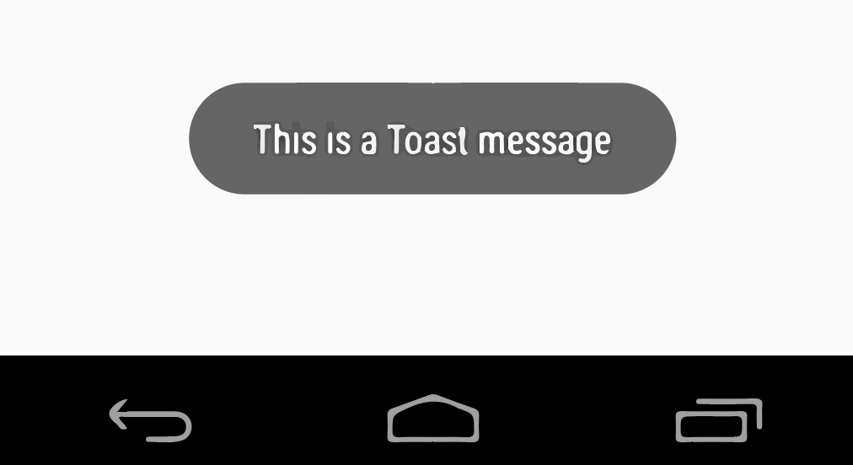
1. Toast
Toast can be created and displayed in Activity or in Servive.
Does not allow user interaction, display will close automatically after a certain period of time.
There are 2 default values:
Toast.LENGTH_SHORT,
Toast.LENGTH_LONG.

Slide 5
1. Toast
Toast t = Toast.makeText(MainActivity.this,
"Welcome to VietNam",
Toast.LENGTH_SHORT); t.show();
Toast.makeText(MainActivity.this,
"Welcome to VietNam",
Toast.LENGTH_LONG).show();

Slide 6
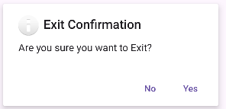
2. Alert Dialog
Displays a dialog box that allows user interaction
AlertDialog.Builder builder = new AlertDialog.Builder(MainActivity.this);

Slide 7
2. Alert Dialog
Some commonly used attributes
setTitle: set the title for Dialog,
setMessage: set the content for Dialog,
setIcon: set Icon,
setPositiveButton, setNegativeButton: set Display Button for Dialog,
create(): to create Dialog,
show(): to display Dialog.

Slide 8
2. Alert Dialog
AlertDialog.Builder builder = new AlertDialog.Builder(MainActivity.this); builder.setTitle("Exit Confirmation"); builder.setIcon(android.R.drawable.ic_dialog_info); builder.setMessage("Are you sure you want to Exit?"); builder.setPositiveButton("Yes", new DialogInterface.OnClickListener() { @Override public void onClick(DialogInterface dialogInterface, int i) { finish(); } }); builder.setNegativeButton("No", new DialogInterface.OnClickListener() { @Override public void onClick(DialogInterface dialogInterface, int i) { dialogInterface.dismiss(); } }); AlertDialog dialog = builder.create(); dialog.show();

Slide 9
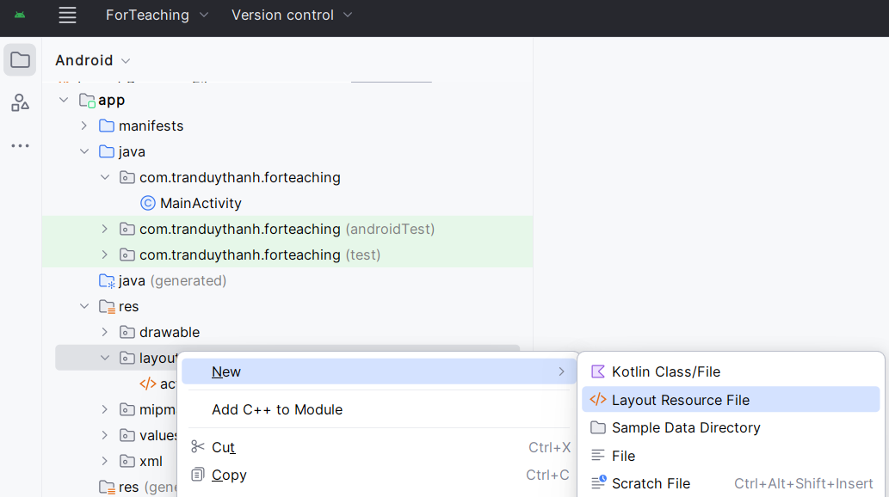
3. Custom Dialog
Sometimes, we want to create a custom dialog for advanced target

Slide 10
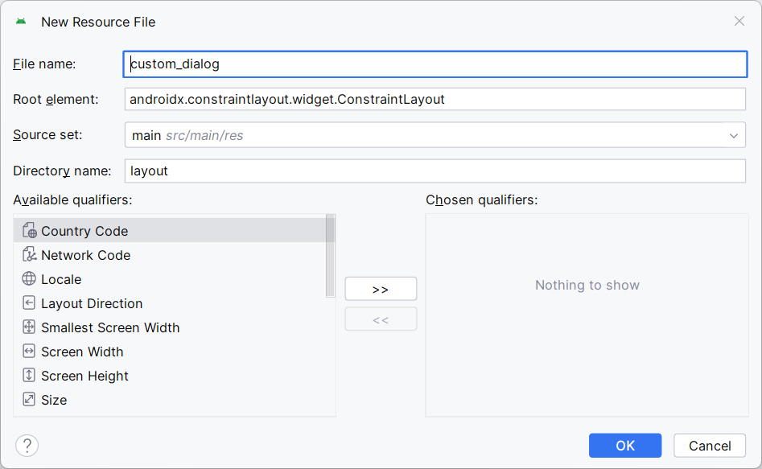
3. Custom Dialog

Slide 11
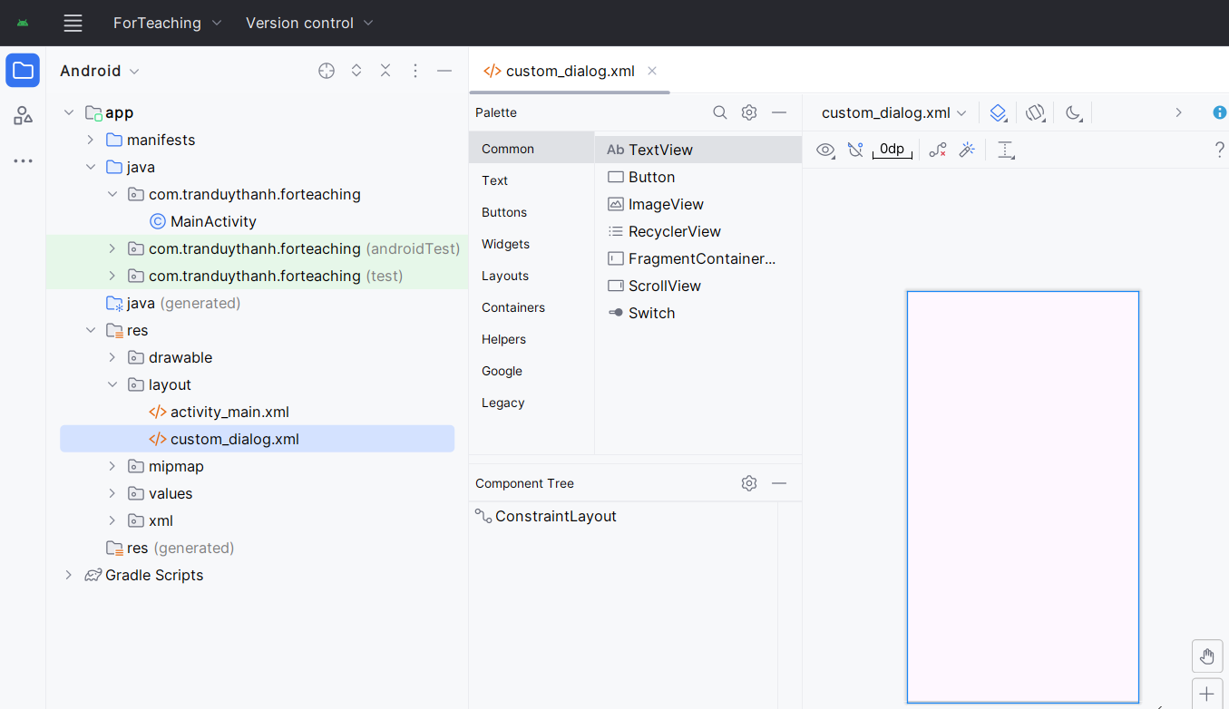
3. Custom Dialog

Slide 12
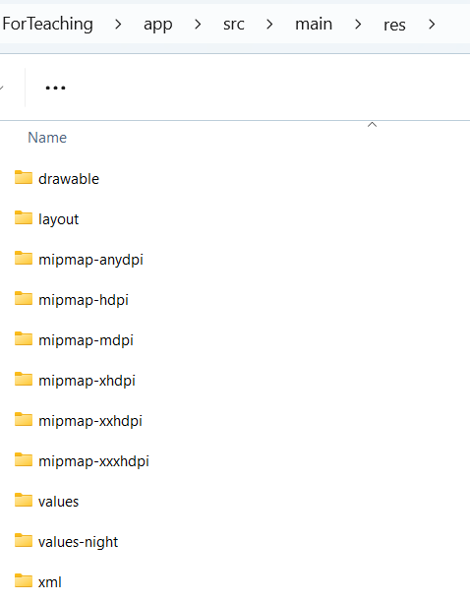
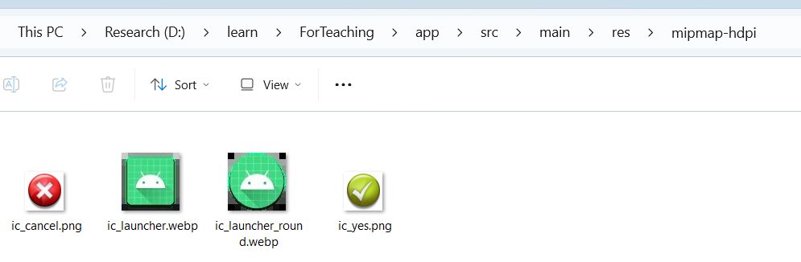
3. Custom Dialog

Slide 13
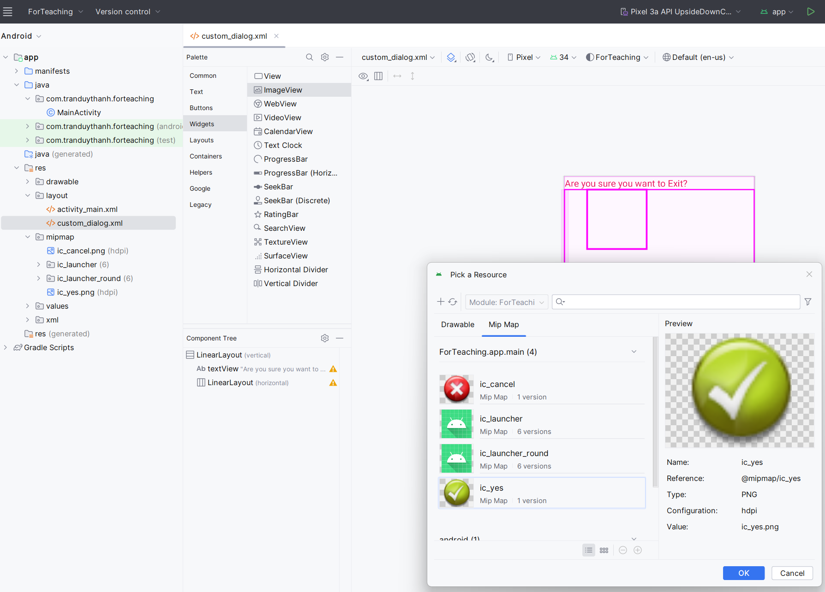
3. Custom Dialog
1
2
3

Slide 14
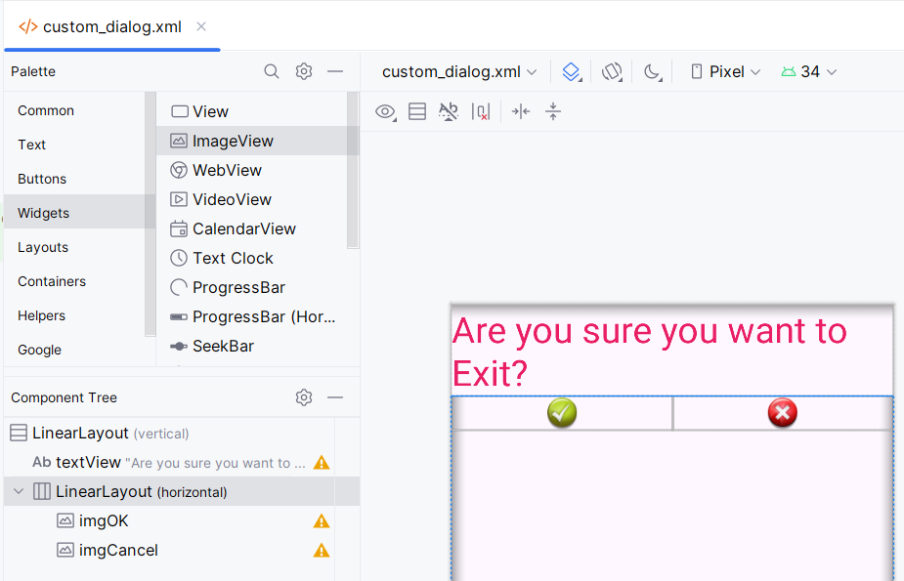
3. Custom Dialog

Slide 15
3. Custom Dialog
<LinearLayout android:layout_width="match_parent" android:layout_height="match_parent" android:orientation="horizontal"> <ImageView android:id="@+id/imgOK" android:layout_width="wrap_content" android:layout_height="wrap_content" android:layout_weight="1" app:srcCompat="@mipmap/ic_yes" /> <ImageView android:id="@+id/imgCancel" android:layout_width="wrap_content" android:layout_height="wrap_content" android:layout_weight="1" app:srcCompat="@mipmap/ic_cancel" /> </LinearLayout> </LinearLayout>
<?xml version="1.0" encoding="utf-8"?> <LinearLayout xmlns:android="http://schemas.android.com/apk/res/android" xmlns:app="http://schemas.android.com/apk/res-auto" android:layout_width="match_parent" android:layout_height="match_parent" android:orientation="vertical"> <TextView android:id="@+id/textView" android:layout_width="match_parent" android:layout_height="wrap_content" android:text="Are you sure you want to Exit?" android:textColor="#E91E63" android:textSize="34sp" />

Slide 16
3. Custom Dialog
Way 1:
Dialog dialog = new Dialog(MainActivity.this); dialog.setContentView(R.layout.custom_dialog); dialog.setCanceledOnTouchOutside(false); ImageView imgOk = dialog.findViewById(R.id.imgOK); imgOk.setOnClickListener(new View.OnClickListener() { @Override public void onClick(View view) { finish(); } }); ImageView imgCancel = dialog.findViewById(R.id.imgCancel); imgCancel.setOnClickListener(new View.OnClickListener() { @Override public void onClick(View view) { dialog.dismiss(); } }); dialog.show();

Slide 17
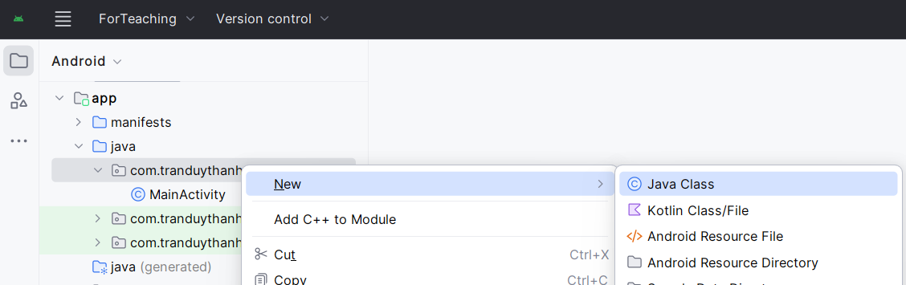
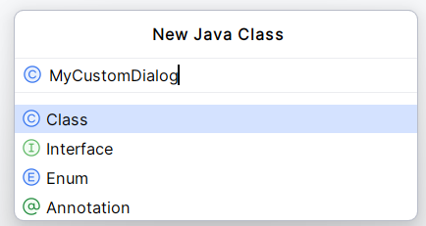
3. Custom Dialog
Way 2:

Slide 18
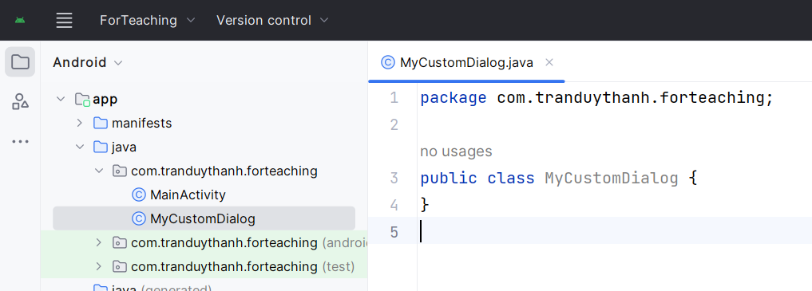
3. Custom Dialog
Way 2:

Slide 19
3. Custom Dialog
package com.tranduythanh.forteaching; import android.app.Activity; import android.app.Dialog; import android.content.Context; import android.view.View; import android.widget.ImageView; import androidx.annotation.NonNull; public class MyCustomDialog extends Dialog { ImageView imgOk, imgCancel; Activity context; public MyCustomDialog(@NonNull Context context) { super(context); this.context = (Activity) context; setContentView(R.layout.custom_dialog); addViews(); setCanceledOnTouchOutside(false); addEvents(); }
Way 2:

Slide 20
3. Custom Dialog
Way 2:
private void addEvents() { imgOk.setOnClickListener(new View.OnClickListener() { @Override public void onClick(View view) { context.finish(); } }); imgCancel.setOnClickListener(new View.OnClickListener() { @Override public void onClick(View view) { dismiss(); } }); } private void addViews() { imgOk = findViewById(R.id.imgOK); imgCancel = findViewById(R.id.imgCancel); } }

Slide 21
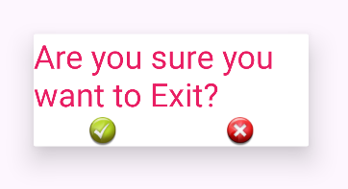
3. Custom Dialog
Way 2:
MyCustomDialog myCustomDialog = new MyCustomDialog(MainActivity.this); myCustomDialog.show();

Slide 22
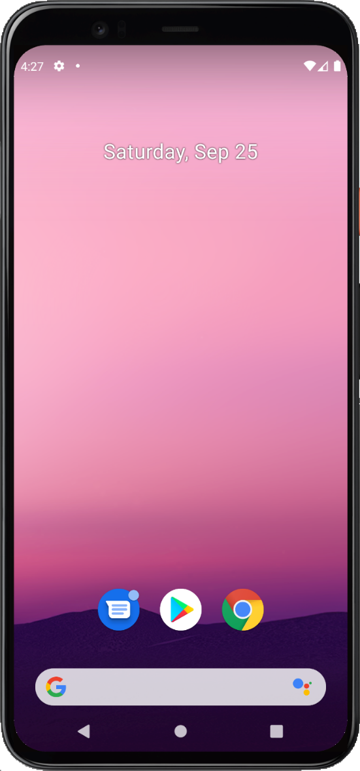
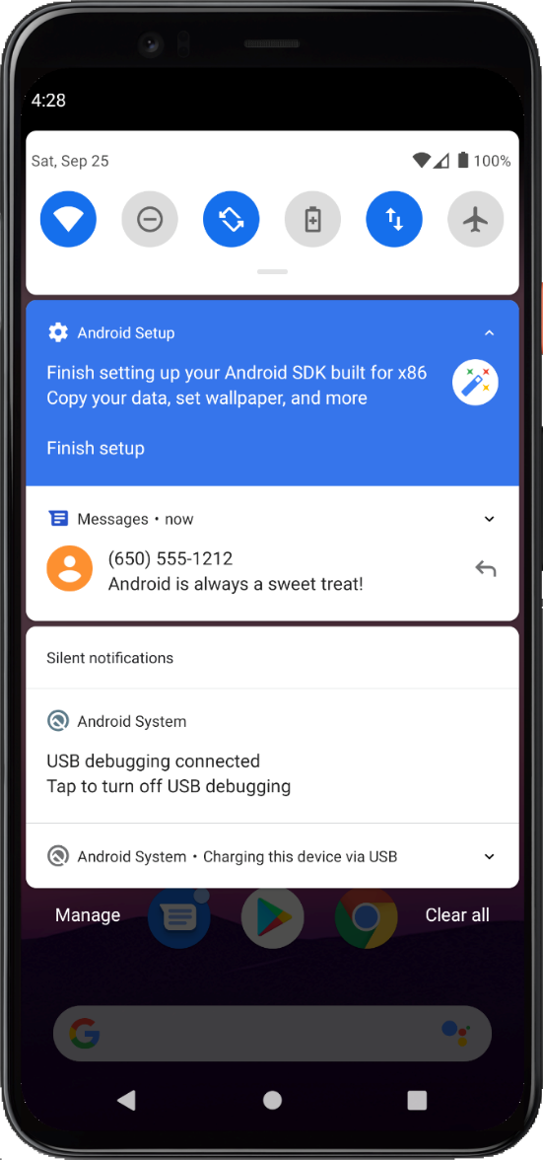
4. Notification
A notification is a message that Android displays outside your app's UI to provide the user with reminders, communication from other people, or other timely information from your app. Users can tap the notification to open your app or take an action directly from the notification.

Slide 23
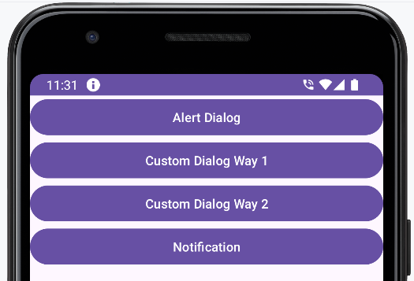
4. Notification
<uses-permission android:name="android.permission.POST_NOTIFICATIONS" />

Slide 24
4. Notification
public void showNotification(View view) { if (ActivityCompat.checkSelfPermission(this, android.Manifest.permission.POST_NOTIFICATIONS) != PackageManager.PERMISSION_GRANTED) { return; } String CHANNEL_ID = "MyChanel"; Notification notification = new NotificationCompat.Builder(this, CHANNEL_ID) .setSmallIcon(android.R.drawable.ic_dialog_info) .setContentTitle("Hello") .setContentText("Hello, I am Notification") .setSound(RingtoneManager.getDefaultUri( RingtoneManager.TYPE_NOTIFICATION)) .setPriority(NotificationCompat.PRIORITY_HIGH) .setCategory(NotificationCompat.CATEGORY_MESSAGE) .build(); NotificationManagerCompat notificationManager = NotificationManagerCompat.from(this); notificationManager.notify(1, notification); }

Slide 25
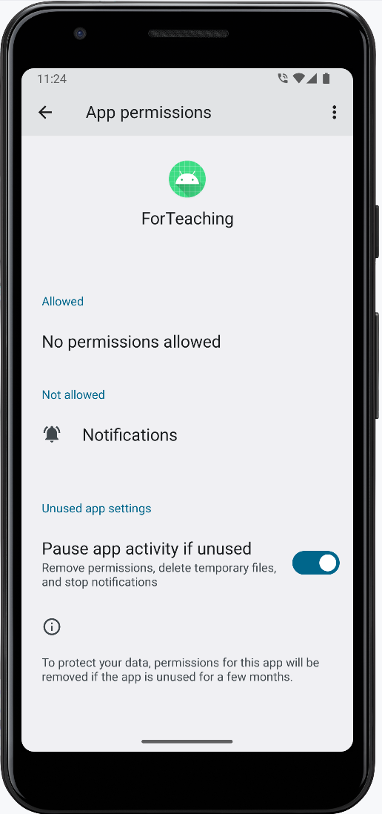
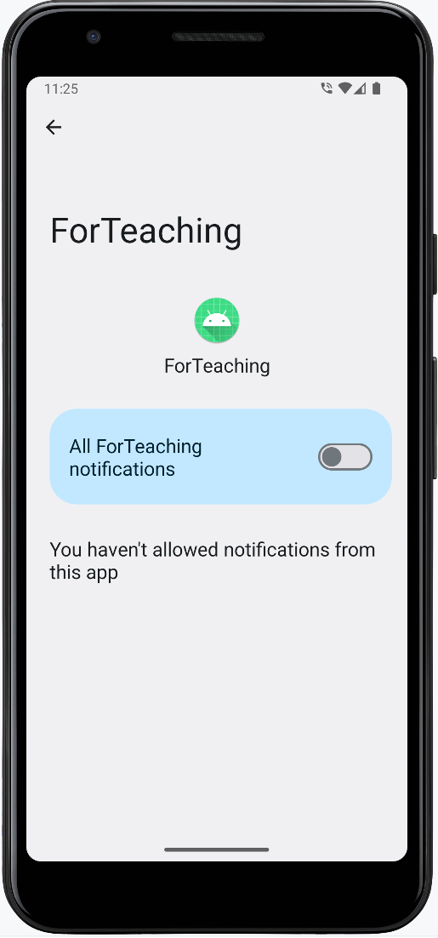
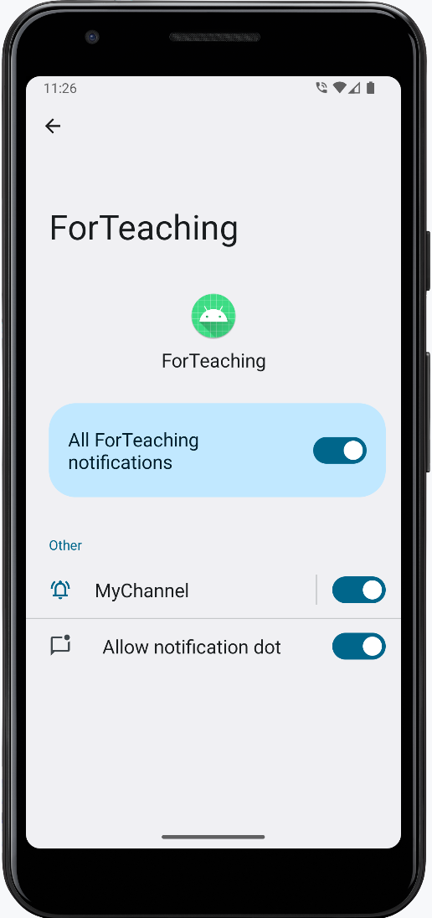
4. Notification
Grant notifications on device

Slide 26
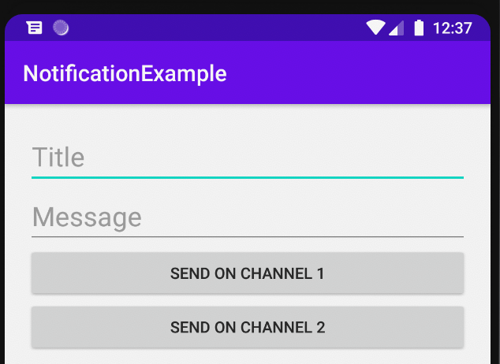
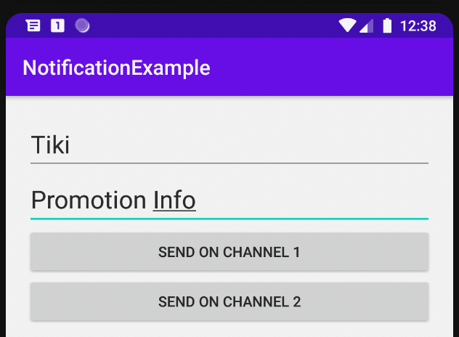
4. Notification
More Demo:

Slide 27
Discussions
Q1: Present the Toast
Q2: Present the AlertDialog
Q3: Present the Custom Dialog with 2 ways
Q4: Present Notification and demo with 2 chanels

Slide 28
Next Lesson
ListView
GridView
RecyclerView
Spinner
AutocompleteTextView
DatePicker, TimePicker
TabHost

Slide 29
THANK YOU!

